Slide 1
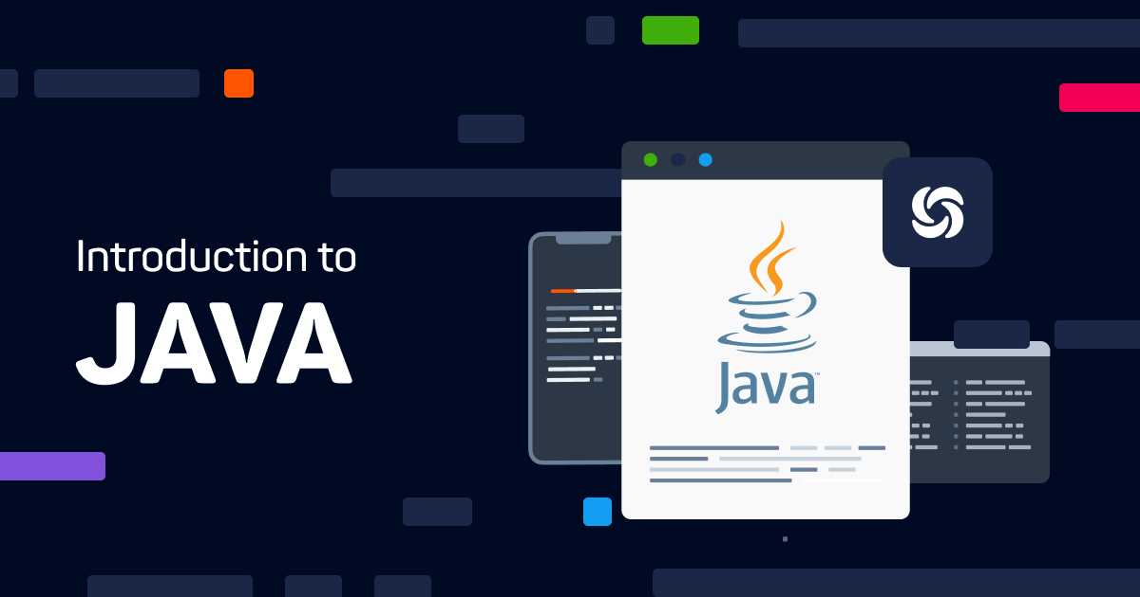
Mrs. Sajja RadhaRani
Assistant Professor, ACSE

Slide 2


Index
History of Java
Byte code and JVM
Java buzzwords
OOP principles
Data types
Variables
Scope of variables
Operators
Control statements
Type conversion and casting
Arrays

Slide 3
Computer Program ?
A computer program is a collection of instructions that performs a specific task when executed by a computer.
(OR)
Set of instructions to manipulate the data

Slide 4
Programming Language ?
Coded language used by programmers to write instructions that a computer can understand to do what the programmer or the computer user wants.

Slide 5
Evolution of Programming Languages
1st generation language / Machine language
2nd generation language / Assembly language
3rd generation language / High – Level language

Slide 6
1. First generation language / Machine language:
It is a native language of computer
Instructions are in the form of 0’s & 1’s.
Computer is a digital device i.e. it can understand 0’s & 1’s
Drawbacks:
1. It is very slow
2. It is very difficult to learn and developing

Slide 7
2.Second generation language / Assembly language:
Instructions are in the form of words / commands
Example: Add a, b
Sub d, b
Assembler translates the assembly language instructions to the machine language
Drawbacks:
1. It is very slow
2. It is difficult to remember all commands.

Slide 8
3.Third generation language / High - Level language:
Syntax are in the form of English.
Procedure oriented programming language
Object oriented programming language

Slide 9
Procedure oriented programming language:
Programmers write code in the form of procedure
Procedure 1
main ( )
Procedure 2
Procedure 3

Slide 10
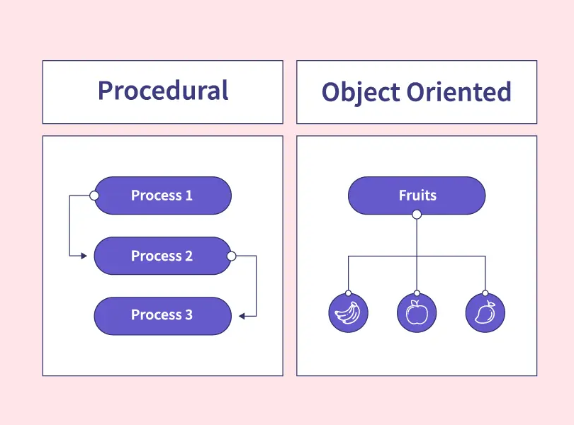
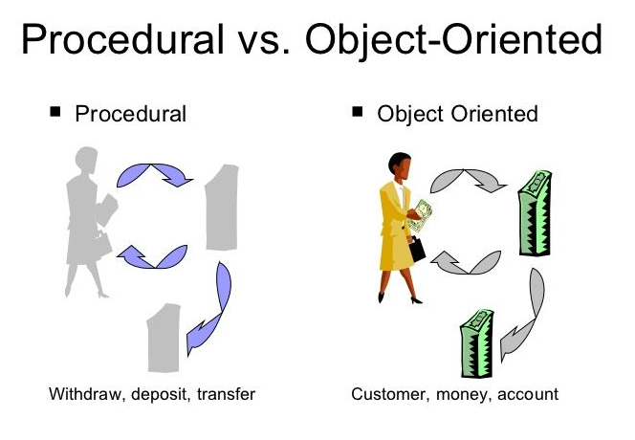

Slide 11
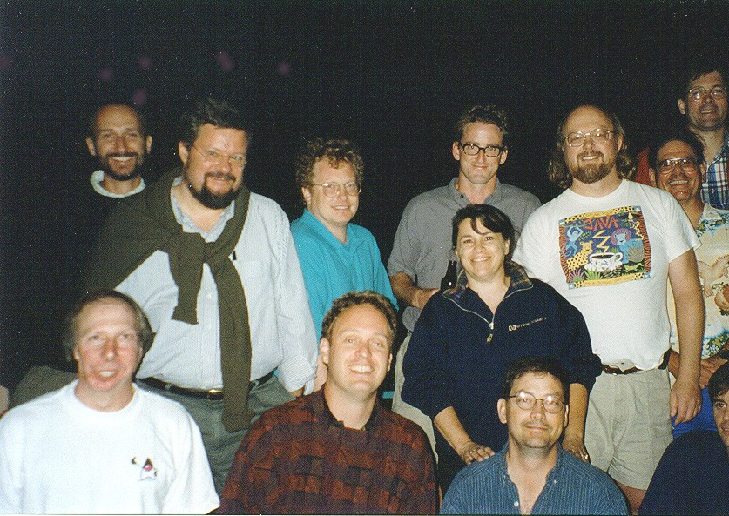
History of Java
It was started in December '90 by Patrick Naughton, Mike Sheridan and James Gosling.
Java, whose original name was Oak, was developed as a part of the Green project at Sun.
It took 18 months to develop the first working version.
This language was initially called “OAK”.
Name changed to JAVA.
First public release in 1995.

Slide 12

Continue . . .
Slogan: "Write Once, Run Anywhere“.
Machine-independent programming language.
Object Oriented Language.
Java is both a compiled and an interpreted language.
Java source code is turned into simple binary instructions, much like ordinary microprocessor machine code.
Compiled Java byte-code is executed by a Java runtime interpreter.

Slide 13
Continue . . .
1996: Sun Microsystems released Java 1.1, which introduced inner classes, JDBC.
1998: Java 2 (J2SE) was released - JDK & JRE.
2004: J2SE 5.0 was released.
2006: Sun Microsystems released Java SE 6.
2014: Java 8 was released-API,
2017: Java 9 was released-JVM
2018: Java 10 was released.
2019: Java 11 was released- HTTP.
2021: Java 16 was released.-Improvements in Garbage Collector.

Slide 14
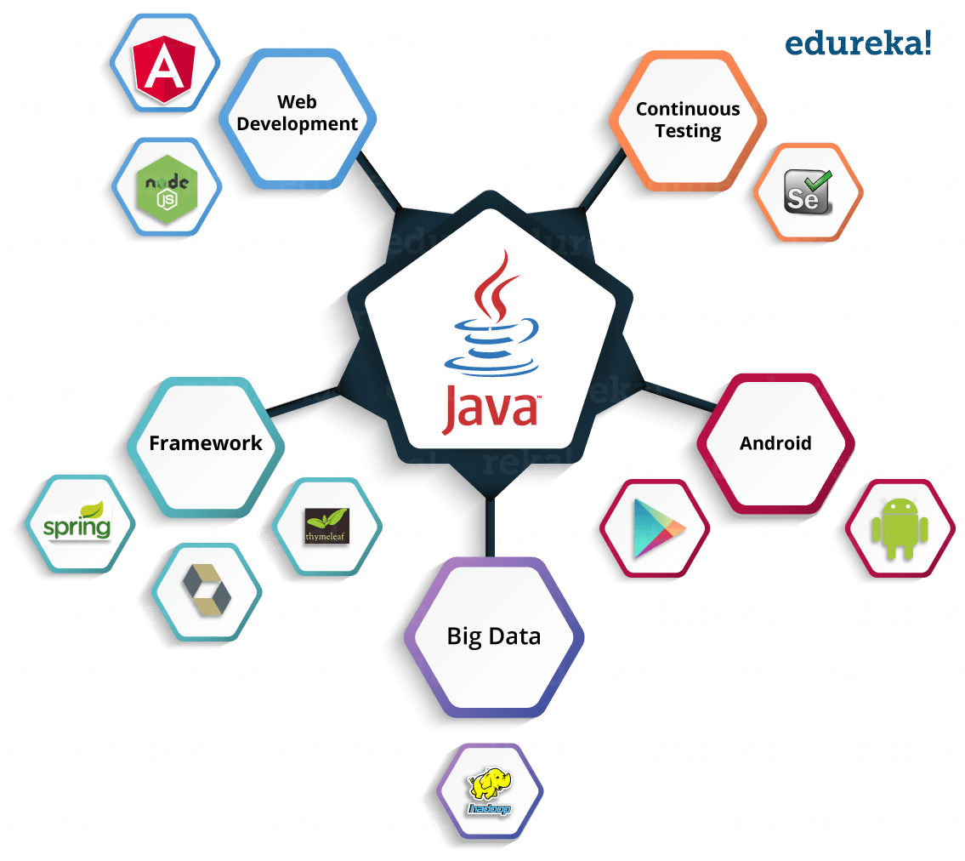
Java Usage
Java is being used to develop traditional applications.
Embedded applications on web pages.
Server-Side Applications.

Slide 15
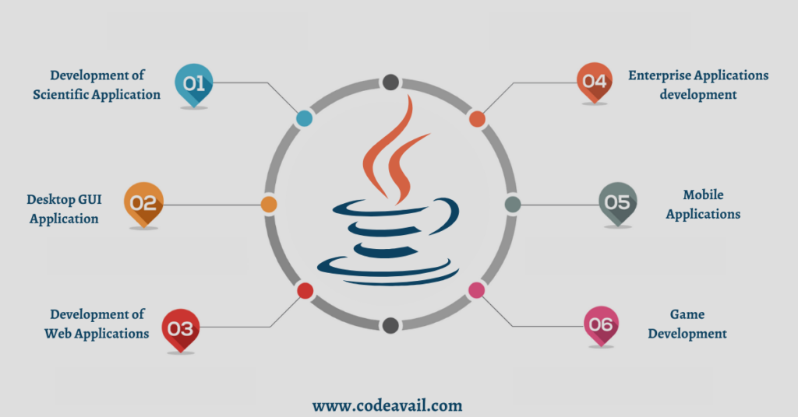

Slide 16
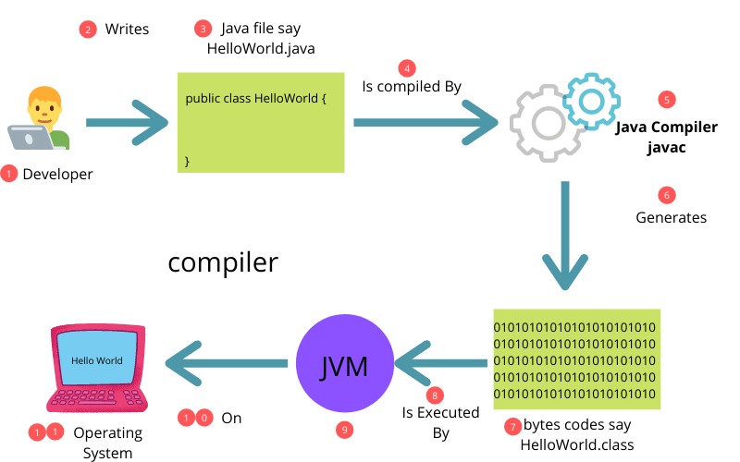
Java Byte Code

Slide 17
Continue . . .
Java bytecode refers to the binary format of the compiled Java source code.
When you write Java code, it is first compiled into bytecode before it can be executed by the Java Virtual Machine (JVM).
Here are some key points about Java bytecode:
Intermediate Representation: Java bytecode serves as an intermediate representation between the high-level Java source code and the low-level machine code.
It is a platform-independent format that can be executed on any system with a compatible JVM.

Slide 18

Continue . . .
Generated by Java Compiler:
The Java compiler (javac) translates the Java source code into bytecode.
This process involves lexical analysis, syntax parsing, and semantic analysis to ensure the code is valid and follows the Java language rules.

Slide 19
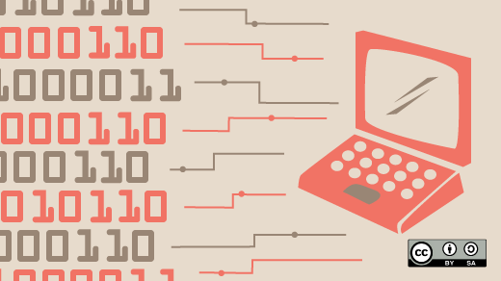
Continue . . .
Bytecode Instructions:
Java bytecode consists of a set of instructions that the JVM understands and can execute.
These instructions are typically compact and optimized for efficient execution.
Examples of bytecode instructions include loading values onto the stack, performing arithmetic operations, method invocation, and control flow instructions like branching and looping.

Slide 20
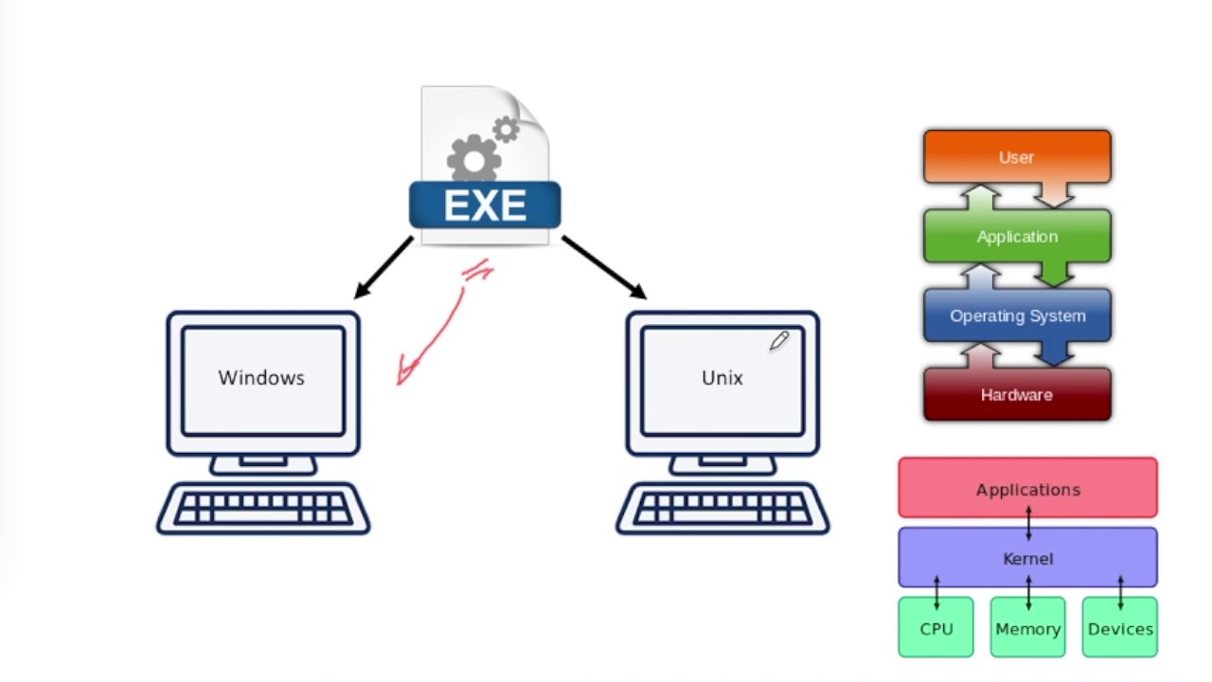
Continue . . .
Platform Independence:
One of the significant advantages of Java bytecode is its platform independence.
Once the Java source code is compiled into bytecode, it can be executed on any platform that has a JVM installed.
This "Write Once, Run Anywhere" feature allows Java applications to be portable and eliminates the need for recompilation for different operating systems.

Slide 21
Continue . . .
JVM Execution:
The JVM is responsible for interpreting and executing Java bytecode.
JVM Provides runtime environment for Java applications.
The JVM's bytecode interpreter reads the bytecode instructions and translates them into machine code instructions that can be understood by the underlying hardware.
In some cases, the JVM can also use Just-In-Time (JIT) compilation to dynamically translate bytecode into native machine code for better performance.

Slide 22
JVM provides several services:
memory management
garbage collection
Security
class loading
optimizing the performance of JIT (just-in-time compilation).
JVM components:
class loader: loads classes into the JVM's memory.
runtime data area: stores data and bytecode.
execution engine: interprets and executes the bytecode.

Slide 23
Continue . . .
Debugging and Decompilation:
Bytecode can be helpful in debugging Java applications.
Debuggers can analyze and manipulate the bytecode to step through the code, set breakpoints, and inspect variables.
Additionally, bytecode can be decompiled back into Java source code, although the resulting code may not be an exact replica of the original source.

Slide 24
Continue . . .
Class File Format:
Bytecode is stored in .class files, which contain the compiled bytecode along with additional metadata about the classes, methods, fields, and interfaces defined in the Java source code.

Slide 25
Java Program Execution
WINDOWS
Java Source Code
Java Byte Code
LINUX
MACINTOSH
Develop
Compile
Execute Using Interpreter

Slide 26
Java Buzzwords
Simple
Secure
Portable
Object-oriented
Robust
Multithreaded
Architecture-neutral
Interpreted
High performance
Distributed
Dynamic

Slide 27
Simple
Java is simple because, professional programmers to learn and use efficiently.
Java inherits the syntax of C/C++ and many of the object-oriented features of C++.
Java language is considerably simpler than C++.
Confusing features such as operator overloading have been eliminated, as have independent functions, global variables, goto statement, structures and pointers.

Slide 28
Secure
The Java language is secure in that it is very difficult to write incorrect code or viruses that can corrupt/steal your data, or harm hardware such as hard disks.
Because of
Eliminating Pointers
Array Bounds Checking
No illegal data conversions
No calls to Native methods

Slide 29

Portable
Portability is a major aspect of the Internet because there are many different types of computers and operating systems connected to it.
Java programs are portable across operating systems and hardware environments.

Slide 30
Object-oriented
Java is Object Oriented Programming.
Unlike other programming languages, Java has no functions and no variables that can exist outside of the class boundaries.
By forcing all programs into an object-oriented structure, the many benefits of object oriented design are much more easily realized (encapsulation, orientation toward reusability).

Slide 31
Robust
Java is ROBUST , to better understand how Java is robust, consider two of the main reasons for program failure: memory management mistakes and mishandled exceptional conditions.
Memory management can be a difficult, tedious task in traditional programming environments.
For example, in C/C++, the programmer must manually allocate and free all dynamic memory. This sometimes leads to problems, because programmers will either forget to free memory that has been previously allocated or, worse, try to free some memory that another part of their code is still using.

Slide 32
Continue . . .
Java virtually eliminates these problems by managing memory allocation and deallocation for you.
Exceptional conditions in traditional environments often arise in situations such as division by zero or “file not found,” and they must be managed with clumsy and hard-to-read constructs. Java helps in this area by providing object-oriented exception handling.
In a well-written Java program, all run-time errors can—and should—be managed by your program.

Slide 33
Multithreaded
Java was designed to meet the real-world requirement of creating interactive, networked programs.
To accomplish this, Java supports multithreaded programming, which allows you to write programs that do many things simultaneously.
The Java run-time system comes with an elegant yet sophisticated solution for multi process synchronization that enables you to construct smoothly running interactive systems.
Java’s easy-to-use approach to multithreading allows you to think about the specific behaviour of your program, not the multitasking subsystem.

Slide 34
One of the main problems facing programmers is that no guarantee exists that if you write a program today, it will run tomorrow—even on the same machine.
Operating system upgrades, processor upgrades, and changes in core system resources can all combine to make a program malfunction.
The Java designers made several hard decisions in the Java language and the Java Virtual Machine in an attempt to alter this situation.
Their goal was “write once; run anywhere, any time, forever.” To a great extent, this goal was accomplished.
Architecture-neutral

Slide 35
Java enables the creation of cross-platform programs by compiling into an intermediate representation called Java byte code.
This code can be executed on any system that implements the Java Virtual Machine.
Most previous attempts at cross-platform solutions have done so at the expense of performance.
As explained earlier, the Java bytecode was carefully designed so that it would be easy to translate directly into native machine code for very high performance by using a just-in-time compiler.
Java run-time systems that provide this feature lose none of the benefits of the platform-independent code.
Interpreted

Slide 36
Distributed
Java is designed for the distributed environment of the Internet because it handles TCP/IP protocols.
In fact, accessing a resource using a URL is not much different from accessing a file.
Java also supports Remote Method Invocation (RMI). This feature enables a program to invoke methods across a network.

Slide 37
Dynamic
Java programs carry with them substantial amounts of run-time type information that is used to verify and resolve accesses to objects at run time.
This makes it possible to dynamically link code in a safe and expedient manner.
This is crucial to the robustness of the Java environment, in which small fragments of bytecode may be dynamically updated on a running system.

Slide 38
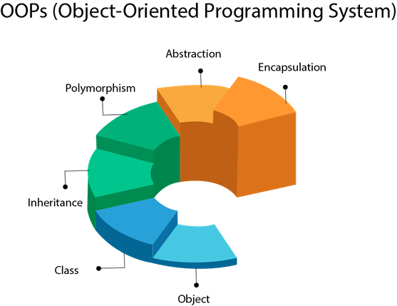

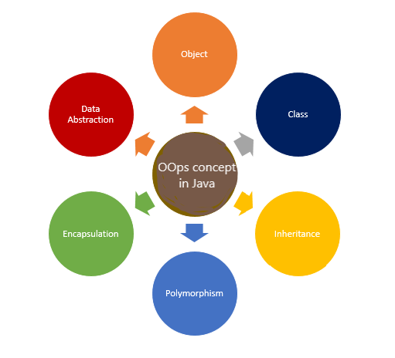
Object Oriented Programming Principles

Slide 39
Class
In Java, a class is a fundamental building block of object-oriented programming (OOP).
It is a blueprint or a template that defines the structure and behavior of objects.
When you create an object from a class, you are instantiating that class, and the object becomes an instance of that class.
In other words, objects are instances of classes.

Slide 40
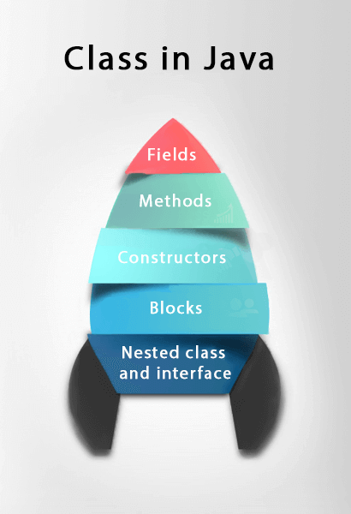
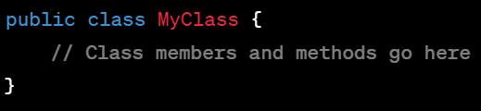
A Java class typically contains the following components
Class Declaration:
The class declaration defines the name of the class and can specify its access level (e.g., public, private, protected, or package-private).
It follows the keyword class and is followed by the class name.

Slide 41
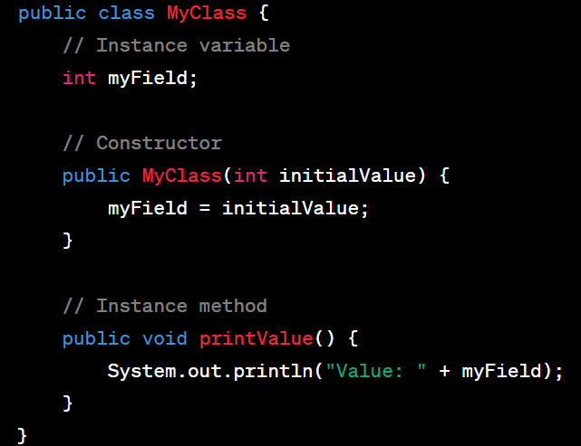
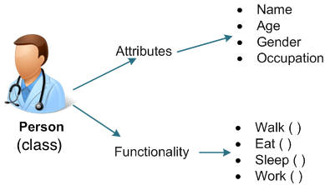
Class Members:
These are the variables (fields) and methods defined within the class.
They represent the data and behaviour of the objects created from the class.

Slide 42
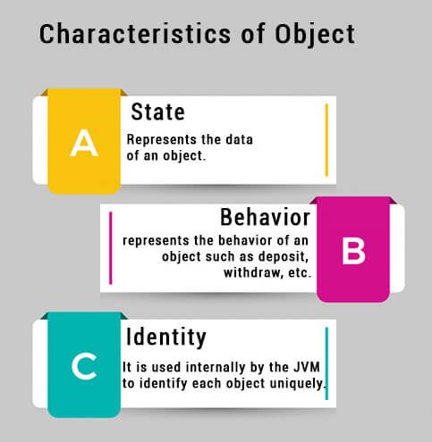
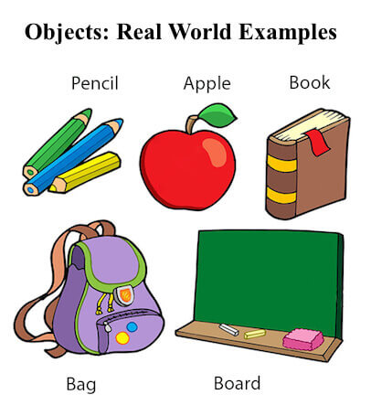
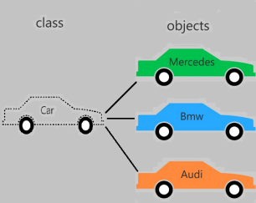
Object
An object is a specific instance created from a class.
It is a concrete representation of the class blueprint, with its unique state and behaviour.

Slide 43

Inheritance

Slide 44
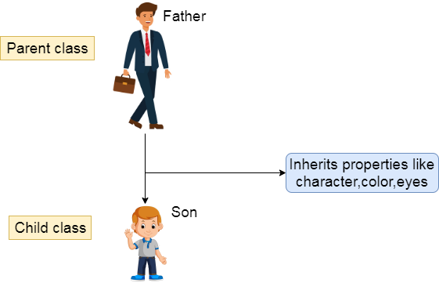
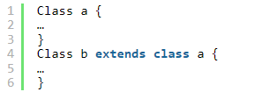
Inheritance
Inheritance is a method in which one object acquires/inherits another object’s properties, and inheritance also supports hierarchical classification.
The idea behind this is that we can create new classes built on existing classes, i.e., when you inherit from an existing class, we can reuse methods and fields of the parent class.
Inheritance represents the parent-child relationship.

Slide 45
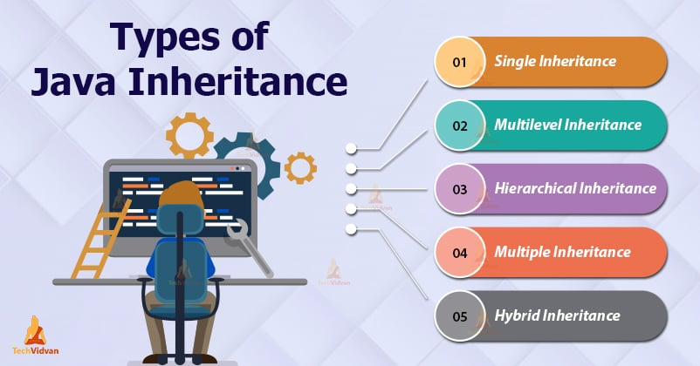

Slide 46
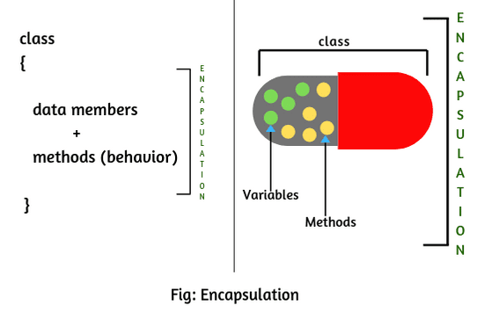
Encapsulation
The process of binding data and corresponding methods (behavior) together into a single unit is called encapsulation in Java.

Slide 47
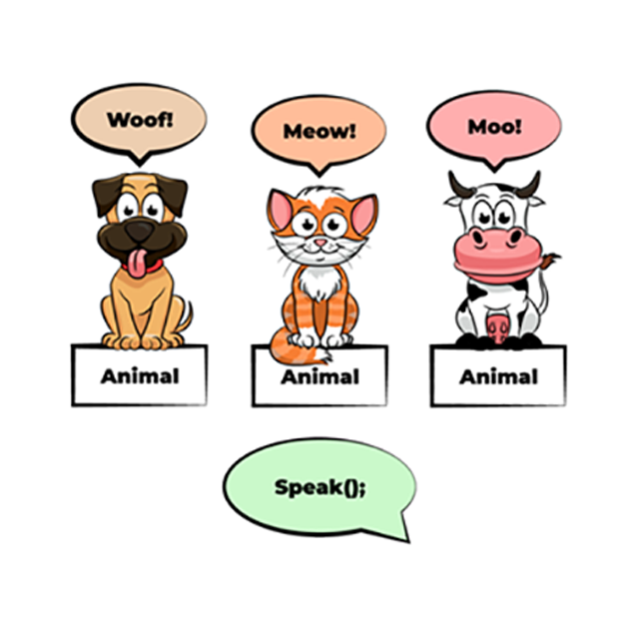
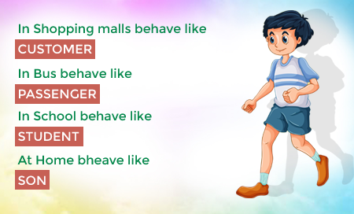
Polymorphism
The word polymorphism originates from two different Greek words poly and morph.
"Poly" means numerous, while “Morphs” means forms.
Polymorphism is the ability of an object to take on many forms.

Slide 48
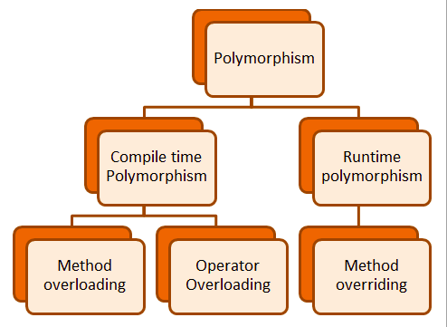
Types of Polymorphism
Compile time or Static Polymorphism.
Runtime or Dynamic Polymorphism.

Slide 49

Abstraction

Slide 50
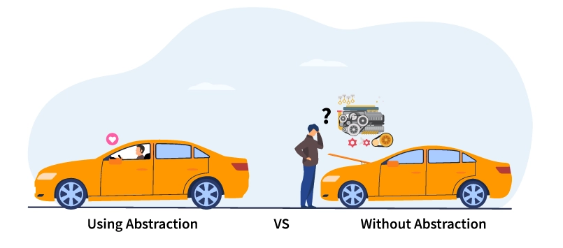
Abstraction
Abstraction is the process of hiding the implementation of the application from the user and presenting only functionalities.
Abstraction can be achieved with either abstract classes or interfaces

Slide 51

Data Types

Slide 52
Data Types
Java is Strongly Typed Language.
Every variable has a type, every expression has a type, and every type is strictly defined.
All assignments, whether explicit or via parameter passing in method calls, are checked for type compatibility.
There are no automatic coercions or conversions of conflicting types as in some languages.
The Java compiler checks all expressions and parameters to ensure that the types are compatible. Any type mismatches are errors that must be corrected before the compiler will finish compiling the class.

Slide 53
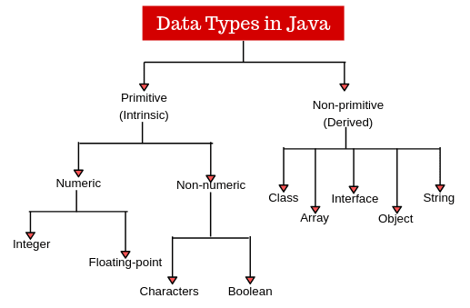

Slide 54
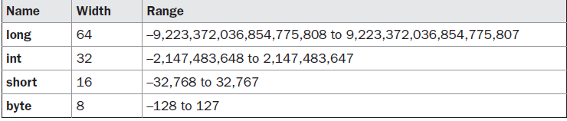
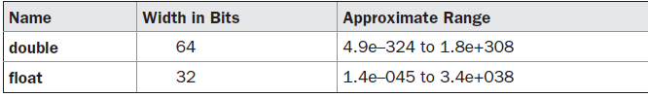
Continue . . .
Primitive Data Types:
Byte
Short
Int
Long
Char
Float
Double
Boolean
Integers
Characters like letters, symbols
Floating Points
True/False

Slide 55
import java.io.*;
import java.util.*;
class Light {
public static void main(String args[]) {
int lightspeed;
long days;
long seconds;
long distance;
lightspeed = 186000; // approximate speed of light in miles per second
days = 1000L; // specify number of days here
seconds = days * 24 * 60 * 60; // convert to seconds
distance = lightspeed * seconds; // compute distance
System.out.print("In " + days);
System.out.print(" days light will travel about ");
System.out.println(distance + " miles.");
}
}

Slide 56
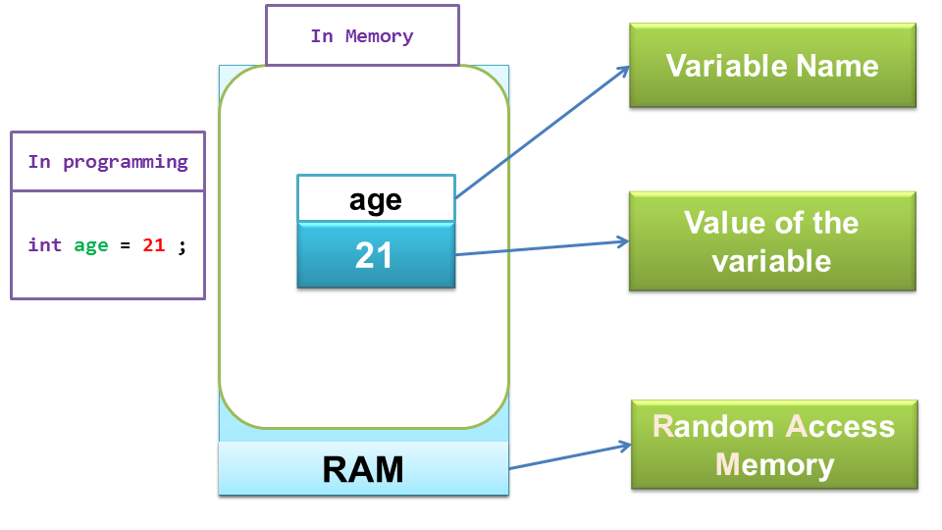
A variable is a container which holds the value.
A variable is assigned with a data type.
Variable is a name of memory location.
Declaring Variables
Syntax:
datatype variableName;
datatype variableName = initialValue;
Examples:
int age;
double salary = 50000.50;
string name, address;
Variables

Slide 57
Assigning Values to Variables:
int age = 25
Using Variables:
int x = 10;
int y = 20;
int sum = x + y;
System.out.println("The sum of x and y is: " + sum);

Slide 58
Scope of variables
In Java, the scope of a variable refers to the region of the program where the variable is accessible or visible.
The scope of a variable is determined by where it is declared within the Java code.
Understanding variable scope is crucial for managing memory efficiently, avoiding naming conflicts, and ensuring the correct behavior of the program.

Slide 59
Types of Variable in Java:
Local Variable
Instance Variable
Static Variable

Slide 60
Local variables
Local variables are declared inside a method, constructor, or block of code.
They are only accessible within the method, constructor, or block where they are declared.
Local variables are not accessible outside the method, constructor, or block, and they are destroyed once the method, constructor, or block execution is completed.
Local variables must be initialized before they are used.

Slide 61
Example:
public void add( )
{
int x = 10; // x is a local variable, its scope is limited to this method
System.out.println(x);
}

Slide 62
Instance Variables
Instance variables are those which are declared inside the class and outside the method.
They are associated with instances (objects) of the class, and their values are specific to each object.
Instance variables are accessible across all methods and constructors within the class.
These can be accessible by using “objectname.variablename”.
They are initialized to default values (e.g., 0 for numbers, null for objects) if not explicitly initialized.

Slide 63
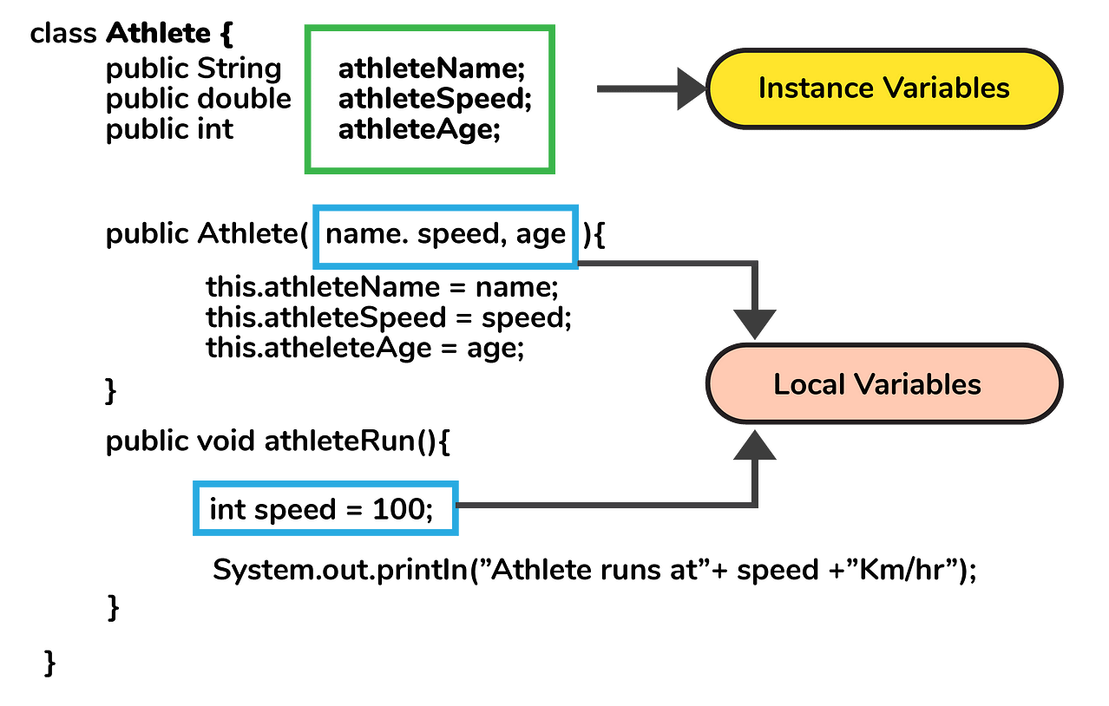

Slide 64
static Variables
Static variables are declared by using "static" keyword.
They are associated with the class itself rather than instances (objects) of the class.
Static variables can be initialised only once.
These are stored in static memory.
These can be accessible by using “classname.variablename”.
They are initialized to default values (e.g., 0 for numbers, null for objects) if not explicitly initialized.

Slide 65
class Data
{
int a=10;
static int b=100;
void method()
{
int c=90;
System.out.println(c);
}
}

Slide 66
class Data
{
int a=10;
static int b=100;
void method()
{
int c=90;
System.out.println(c);
}
}
class main
{
public static void main(String args[])
{
Data d=new Data( );
System.out.println(d.a);
System.out.println(Data.b);
d.method();
}
}

Slide 67
class Data
{
private int a=10;
private static int b=100;
void method()
{
int c=90;
System.out.println(c);
}
}
class main
{
public static void main(String args[])
{
Data d=new Data( );
System.out.println(d.a);
System.out.println(Data.b);
d.method();
}
}

Slide 68
class Data
{
int a=10;
static int b=100;
void method()
{
int c=90;
System.out.println(a);
System.out.println(b);
System.out.println(c);
}
}
class main
{
public static void main(String args[])
{
Data d=new Data();
d.method();
}
}

Slide 69
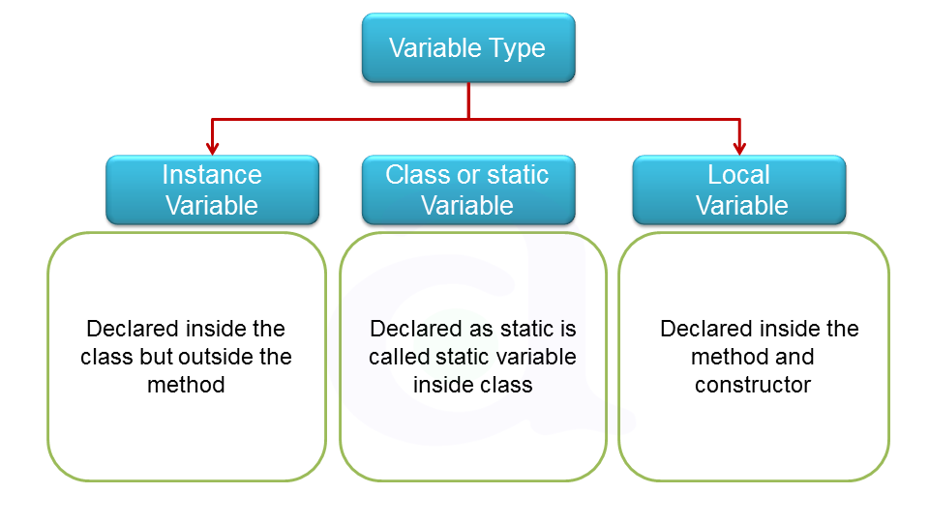

Slide 70
Type Conversions:
Conversion of data from one data type to another.
byte, short, char, int, long, float, double
Lower ←----------------------------→ Higher
In this we have two different types, they are
1.implicit conversion
2.explicit conversion

Slide 71
1.implicit conversion
It is also called as widening conversion
When the smaller data type is converted into higher data type
It will be done by compiler itself.
Example 1: char ch=‘A’;
int num = ch;
Example 2: int x=9500;
float sal=x;

Slide 72
2.explicit conversion:
It is also called as narrowing conversion
When the higher data type is converted into smaller data type
Example: double i=15.12563;
int n = i; //Error
int n = (int) i;

Slide 73
Type casting:
Syntax: (target datatype) value;
We can assign value of a variable of one type to a variable of another type
In explicit conversion programmer explicitly specifies the target data type.

Slide 74
Difference Between Type Casting and Type Conversion
S.No | Type Casting | Type Conversion
1 | Type casting is a mechanism in which one data type is converted to another data type using a casting () operator by a programmer. | Type conversion allows a compiler to convert one data type to another data type at the compile time of a program or code.
2 | It can be used both compatible data type and incompatible data type. | Type conversion is only used with compatible data types, and hence it does not require any casting operator.
3 | It requires a programmer to manually casting one data into another type. | It does not require any programmer intervention to convert one data type to another because the compiler automatically compiles it at the run time of a program.
4 | It is used while designing a program by the programmer. | It is used or take place at the compile time of a program.
5 | When casting one data type to another, the destination data type must be smaller than the source data. | When converting one data type to another, the destination type should be greater than the source data type.
6 | It is also known as narrowing conversion because one larger data type converts to a smaller data type. | It is also known as widening conversion because one smaller data type converts to a larger data type.
7 | It is more reliable and efficient. | It is less efficient and less reliable.
8 | There is a possibility of data or information being lost in type casting. | In type conversion, data is unlikely to be lost when converting from a small to a large data type.
9 | float b = 3.0; int a = (int) b | int x = 5, y = 2, c; float q = 12.5, p; p = q/x;

Slide 75
Operators

Slide 76
Operators
Unary Operator,
Arithmetic Operator
Shift Operator
Relational Operator
Bitwise Operator
Logical Operator
Ternary Operator and
Assignment Operator

Slide 77
Operator Type | Category | Precedence
Unary | postfix | expr++ expr--
 | prefix | ++expr --expr +expr -expr ~ !
Arithmetic | multiplicative | * / %
 | additive | + -
Shift | shift | << >> >>>
Relational | comparison | < > <= >= instanceof
 | equality | == !=
Bitwise | bitwise AND | &
 | bitwise exclusive OR | ^
 | bitwise inclusive OR | |
Logical | logical AND | &&
 | logical OR | ||
Ternary | ternary | ? :
Assignment | assignment | = += -= *= /= %= &= ^= |= <<= >>= >>>=

Slide 78
Unary Operator
Example1: ++ and --
public class OperatorExample{
public static void main(String args[]){
int x=10;
System.out.println(x++);//10 (11)
System.out.println(++x);//12
System.out.println(x--);//12 (11)
System.out.println(--x);//10
}}
Example2: ++ and --
public class OperatorExample{
public static void main(String args[]){
int a=10;
int b=10;
System.out.println(a++ + ++a);//10+12=22
System.out.println(b++ + b++);//10+11=21
}
}

Slide 79
Example: ~ !
public class OperatorExample{
public static void main(String args[]){
int a=10;
int b=-10;
boolean c=true;
boolean d=false;
System.out.println(~a);//-11 (minus of total positive value which starts from 0)
System.out.println(~b);//9 (positive of total minus, positive starts from 0)
System.out.println(!c);//false (opposite of boolean value)
System.out.println(!d);//true
} }

Slide 80
Arithmetic Operators
Example 01:
public class OperatorExample{
public static void main(String args[]){
int a=10;
int b=5;
System.out.println(a+b);//15
System.out.println(a-b);//5
System.out.println(a*b);//50
System.out.println(a/b);//2
System.out.println(a%b);//0
} }
Example 02:
public class OperatorExample{
public static void main(String args[])
{
System.out.println(10*10/5+3-1*4/2);
}
}

Slide 81
Java Left Shift Operator
public class OperatorExample{
public static void main(String args[]){
System.out.println(10<<2);//10*2^2=10*4=40
System.out.println(10<<3);//10*2^3=10*8=80
System.out.println(20<<2);//20*2^2=20*4=80
System.out.println(15<<4);//15*2^4=15*16=240
}
}

Slide 82
Java Right Shift Operator
public Class OperatorExample{
public static void main(String args[]){
System.out.println(10>>2);//10/2^2=10/4=2
System.out.println(20>>2);//20/2^2=20/4=5
System.out.println(20>>3);//20/2^3=20/8=2
}
}

Slide 83
Logical && and Bitwise &
The logical && operator doesn't check the second condition if the first condition is false. It checks the second condition only if the first one is true.
The bitwise & operator always checks both conditions whether first condition is true or false.
Example: public class OperatorExample{
public static void main(String args[]){
int a=10;
int b=5;
int c=20;
System.out.println(a<b&&a<c);//false
System.out.println(a<b&a<c);//false
}}

Slide 84
Logical || and Bitwise |
public class OperatorExample{
public static void main(String args[]){
int a=10;
int b=5;
int c=20;
System.out.println(a>b||a<c);//true
System.out.println(a>b|a<c);//true
}}

Slide 85
Java Ternary Operator Example
public class OperatorExample
{
public static void main(String args[])
{
int a=2;
int b=5;
int min=(a<b)?a:b; //2
System.out.println(min);
}
}

Slide 86
Java Assignment Operator
public class OperatorExample{
public static void main(String[] args){
int a=10;
a+=3;//10+3
System.out.println(a);
a-=4;//13-4
System.out.println(a);
a*=2;//9*2
System.out.println(a);
a/=2;//18/2
System.out.println(a);
} }

Slide 87
Control Statements
In Java, control statements are used to control the flow of execution in a program.
They allow you to make decisions, repeat code blocks, and perform different actions based on specific conditions.
Java provides several control statements that enable you to implement logic and algorithms in your programs efficiently.
The main control statements in Java include:

Slide 88
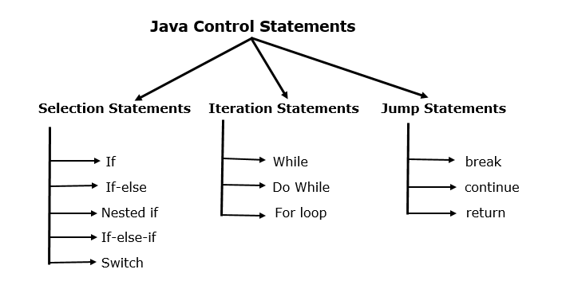

Slide 89
Decision-Making/Selection statements
If Statement:
Simple if statement
if-else statement
if-else-if ladder
Nested if-statement

Slide 90
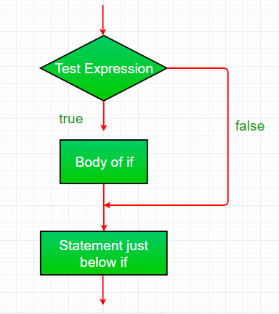
Example:
public class Student
{
public static void main(String[] args)
{
int x = 10;
int y = 12;
if(x+y > 20)
{
System.out.println("x + y is greater than 20");
}
System.out.println(“Hello All");
}
}
Simple if statement:
if(condition)
{
statement 1; //executes when condition is true
}

Slide 91
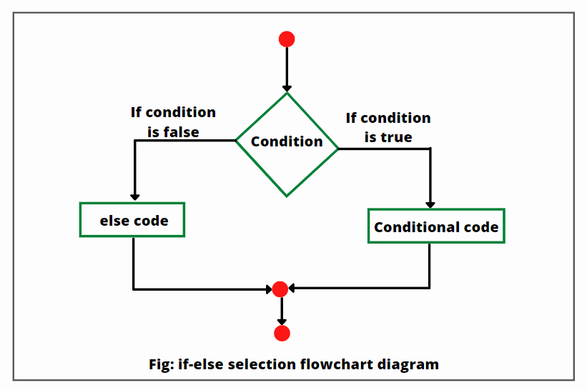
if-else statement:
It allows you to execute a block of code based on a condition. If the condition is true, the code inside the "if" block is executed; otherwise, the code inside the "else" block (optional) is executed.
Syntax:
if(condition)
{
statement 1; //executes when condition is true
}
else
{
statement 2; //executes when condition is false
}

Slide 92
Example:
public class Student {
public static void main(String[] args) {
int x = 10;
int y = 12;
if(x+y < 10)
{
System.out.println("x + y is less than 10");
}
else
{
System.out.println("x + y is greater than 20");
}
} }

Slide 93
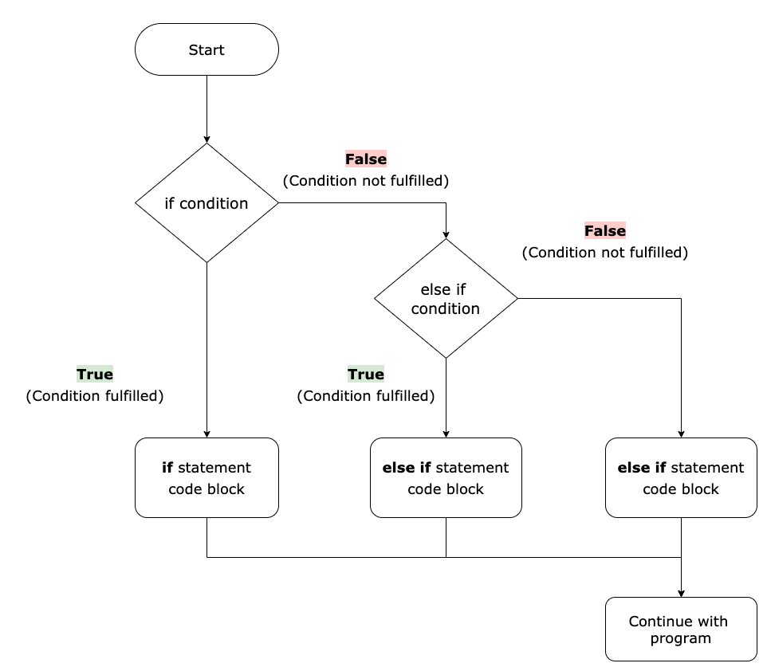
if-else-if ladder:
if(condition 1)
{
statement 1; //executes when condition 1 is true
}
else if(condition 2)
{
statement 2; //executes when condition 2 is true
}
else
{
statement 2; //executes when all the conditions are false
}

Slide 94
public class Student
{
public static void main(String[] args) {
String city = "Delhi";
if(city == "Meerut")
{
System.out.println("city is meerut");
}
else if (city == "Noida")
{
System.out.println("city is noida");
}
else if(city == "Agra")
{
System.out.println("city is agra");
}
else
{
System.out.println(city);
} } }

Slide 95
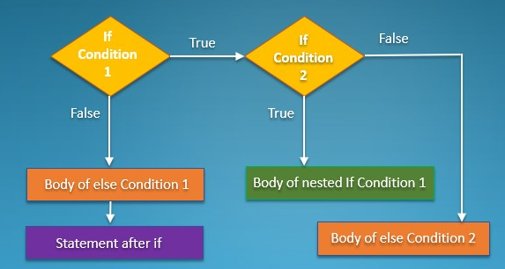
Nested if-statement:
if(condition 1)
{
statement 1; //executes when condition 1 is true
if(condition 2)
{
statement 2; //executes when condition 2 is true
}
else
{
statement 2; //executes when condition 2 is false
}
}

Slide 96
Example:
import java.util.*;
import java.lang.*;
import java.io.*;
class GFG
{
public static void main(String args[])
{
int a=10;
int b=20;
if(a==10){
if(b==20)
{
System.out.println("GeeksforGeeks");
} }
} }

Slide 97
Switch Statement
switch (expression)
{
case value1:
statement1;
break;
.
.
case valueN:
statementN;
break;
default:
default statement;
}

Slide 98
Example:
public class Student implements Cloneable {
public static void main(String[ ] args) {
int num = 2;
switch (num){
case 0:
System.out.println("number is 0");
break;
case 1:
System.out.println("number is 1");
break;
default:
System.out.println(num);
}
} }

Slide 99
Practice:
Write a Java program to get a number from the user and print whether it is positive or negative.
Test Data Input number: 35 Expected Output : Number is positive
Write a Java program to solve quadratic equations (use if, else if and else).
Test Data Input a: 1 Input b: 5 Input c: 1 Expected Output : The roots are -0.20871215252208009 and -4.7912878474779195

Slide 100
Write a Java program that takes three numbers from the user and prints the greatest number.
Test Data Input the 1st number: 25 Input the 2nd number: 78 Input the 3rd number: 87 Expected Output : The greatest: 87
Write a Java program that reads a floating-point number and prints "zero" if the number is zero. Otherwise, print "positive" or "negative". Add "small" if the absolute value of the number is less than 1, or "large" if it exceeds 1,000,000.
Test Data
Input a number: 25
Expected Output :
Input value: 25
Positive number

Slide 101
Write a Java program that takes a number from the user and generates an integer between 1 and 7. It displays the weekday name.
Test Data Input number: 3 Expected Output : Wednesday
Write a Java program to find the number of days in a month.
Test Data Input a month number: 2 Input a year: 2016 Expected Output : February 2016 has 29 days

Slide 102
Write a Java program that takes a year from the user and prints whether it is a leap year or not.
Test Data Input the year: 2016 Expected Output : 2016 is a leap year

Slide 103
Loop Statements
for loop
while loop
do-while loop
for loop: It repeatedly executes a block of code based on a specified condition.
for(initialization, condition, increment/decrement)
{
//block of statements
}

Slide 104
Example:
public class Calculattion
{
public static void main(String[] args)
{
int sum = 0;
for(int j = 1; j<=10; j++)
{
sum = sum + j;
}
System.out.println("The sum of first 10 natural numbers is " + sum);
}
}
Output:55

Slide 105
for-each loop
Syntax:
for (data_type var : array_name/collection_name)
{
//statements
}

Slide 106
Example:
public class Calculation {
public static void main(String[] args) {
String[] names = {"Java","C","C++","Python","JavaScript"};
System.out.println("Printing the content of the array names:\n");
for(String name:names)
{
System.out.println(name);
}
}
}

Slide 107
while loop
It executes a block of code repeatedly as long as a specified condition is true.
Syntax:
while(condition)
{
//looping statements
}
int count = 0;
while (count < 5) {
System.out.println("Count: " + count); count++;
}

Slide 108
Example:
public class Calculation {
public static void main(String[] args) {
int i = 0;
System.out.println("Printing the list of first 10 even numbers \n");
while(i<=10)
{
System.out.println(i);
i = i + 2;
}
} }

Slide 109
do-while loop
It is similar to the while loop, but it executes the block of code at least once before checking the condition.
Syntax:
do
{
//statements
}
while (condition);
int x = 0;
do {
System.out.println("Value of x: " + x); x++;
} while (x < 5);

Slide 110
Example:
public class Calculation {
public static void main(String[] args) {
int i = 0;
System.out.println("Printing the list of first 10 even numbers \n");
do {
System.out.println(i);
i = i + 2;
}while(i<=10);
}
}

Slide 111
Jump Statements
Break Statement: It is used to terminate a loop prematurely when a specific condition is met.
Example:
public class BreakExample {
public static void main(String[] args) {
for(int i = 0; i<= 10; i++)
{
System.out.println(i);
if(i==6)
{
break;
}
}
} }
for (int i = 0; i < 10; i++) {
if (i == 5) {
break;
} System.out.println("Iteration: " + i);
}

Slide 112
Continue Statement: It is used to skip the rest of the loop iteration and move to the next iteration based on a condition.
Example:
class Main {
public static void main(String[] args) {
for (int i = 1; i <= 10; ++i)
{
if (i > 4 && i < 9)
{
continue;
}
System.out.println(i);
}
} }
for (int i = 0; i < 10; i++) {
if (i % 2 == 0) {
continue;
}
System.out.println("Odd number: " + i);
}

Slide 113
Arrays
An Array represents a group of elements of same data type.
In c/c++ arrays are created on static memory i.e memory allocated at compile time.
In java arrays are created on dynamic memory i.e memory allocated at run time.
In Java, an array is a data structure that allows you to store a fixed-size, ordered collection of elements of the same data type.
Arrays provide a way to efficiently store and access multiple values under a single variable name.
The elements in an array are referenced by their index, which starts at 0 and goes up to the array length minus one.

Slide 114
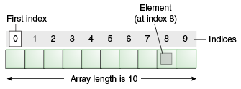
Example: Salary [3]
Here , Salary – array name
[3] – index number (or) subscript
Here represents the salary of 4th employee bcoz array index starts from zero.
The individual values are called Elements.
Array can be of any primitive datatype.

Slide 115
Declaration of Array:
Arrays in java may be declared in two forms.
1. datatype arrayname [];
2. datatype [] arrayname;
Example: int marks [];
float [] number;
We should not mention the size of the array in declaration.

Slide 116
Creation of Array:
After declaring an array memory should be allocated.
Java allows the creation of array using new keyword.
datatype arrayname []; // declaration
number = new int [5]; //creation
(or)
int number[ ] = new int[5];

Slide 117
Assign values in the memory location:
class Creation
{
p s v m( S args[])
{
double rate [] = new double [3];
rate [0] = 20.159;
rate [1] = 58.367;
rate [2] = 13.587
S.o.pln(“ Number of elements are” + rate.length);

Slide 118
S.o.pln(“ second element in rate array is ” + rate[1]);
S.o.p (“ elements are”);
for(int i=0;i<rate.length;i++)
{
S.o.pln( rate [i] +”, “);
}
}
}

Slide 119
S.o.pln(“ second element in rate array is ” + rate.[1]);
S.o.p (“ elements are”);
for(int i=0;i<rate.length;i++)
{
S.o.pln( rate [i] +”, “);
}
}
}

Slide 120
Types of Arrays:
One dimensional array (1D)
Multidimensional array (2D,3D,….)

Slide 121
One dimensional array:
A One dimensional array represents a single row or a single column of elements.
datatype arrayname [] = { val 1,val 2.....val n};
Example:- int a [] = {1,2,3}
Marks obtained by a student in 5 subjects are:
int marks [] = {55, 64, 66, 74, 24}

Slide 122
Multidimensional Array:
It means array of arrays.
Multidimensional array represents several rows & columns of elements.
Example: - A class students are obtained marks in 5 subjects.
Student1 – 50, 51, 52, 53, 54
Student2 – 60, 61, 62, 63, 64
Student3 – 70, 71, 72, 73, 74

Slide 123
We can declare and initialize directly.
Example:
int sales [ ] [ ] = new int [2] [3]
int marks[ ] [ ] = { 50, 51, 52, 53, 54}, {60, 61, 62, 63, 64}
JVM allot memory for the above array.
123

Slide 124
Example: class Transpose
{
p s v m( S args[ ])
{
Scanner sc=new Scanner(System.in);
System.out.println(“enter rows, columns”);
int a=sc.nextInt( );
int b=sc.nextInt( );
int arr[ ] [ ] = new int [a] [b]; // array creation

Slide 125
System.out.println(“enter elements of matrix:”);
for (int i=0; i<a; i++)
for (int j=0; j<b; j++)
arr[i][j]=sc.nextInt( );
System.out.println(“the transpose matrix: ”);
for (int i=0; i<b; i++)
{
for (int j=0; j<a; j++)
{

Slide 126
System.out.println(arr[j][i]+” “);
}
System.out.println(“\n”);
}
}
}

Slide 127
For-each Loop for Java Array
class Testarray1
{
public static void main(String args[])
{
int arr[]={33,3,4,5};
//printing array using for-each loop
for(int i:arr)
System.out.println(i);
}
}

Slide 128
ArrayIndexOutOfBoundsException in a Java Array
public class TestArrayException
{
public static void main(String args[])
{
int arr[]={50,60,70,80};
for(int i=0;i<=arr.length;i++) or (for(int i=0;i<=arr.length-1;i++)
{
System.out.println(arr[i]);
}
}
}

Slide 129
Jagged Array in Java
If we are creating odd number of columns in a 2D array, it is known as a jagged array. In other words, it is an array of arrays with different number of columns.
Example:
class TestJaggedArray{
public static void main(String[] args){
//declaring a 2D array with odd columns
int arr[][] = new int[3][];
arr[0] = new int[3];
arr[1] = new int[4];
arr[2] = new int[2];

Slide 130
//initializing a jagged array
int count = 0;
for (int i=0; i<arr.length; i++)
for(int j=0; j<arr[i].length; j++)
arr[i][j] = count++;
//printing the data of a jagged array
for (int i=0; i<arr.length; i++){
for (int j=0; j<arr[i].length; j++){
System.out.print(arr[i][j]+" "); Output: 0 1 2
} 3 4 5 6
System.out.println();//new line 7 8
}
} }

Slide 131
Addition of two matrices
class Testarray5{
public static void main(String args[]){
//creating two matrices
int a[][]={{1,3,4},{3,4,5}};
int b[][]={{1,3,4},{3,4,5}};
//creating another matrix to store the sum of two matrices
int c[][]=new int[2][3];
//adding and printing addition of 2 matrices
for(int i=0;i<2;i++){
for(int j=0;j<3;j++){
c[i][j]=a[i][j]+b[i][j];
System.out.print(c[i][j]+" ");
}
System.out.println(); //new line
}
}}

Slide 132
Multiplication of 2 Matrices
public class MatrixMultiplicationExample{
public static void main(String args[]){
//creating two matrices
int a[][]={{1,1,1},{2,2,2},{3,3,3}};
int b[][]={{1,1,1},{2,2,2},{3,3,3}};
//creating another matrix to store the multiplication of two matrices
int c[][]=new int[3][3]; //3 rows and 3 columns
//multiplying and printing multiplication of 2 matrices
for(int i=0;i<3;i++){
for(int j=0;j<3;j++){
c[i][j]=0;
for(int k=0;k<3;k++)
{
c[i][j]+=a[i][k]*b[k][j];
} //end of k loop
System.out.print(c[i][j]+" "); //printing matrix element
} //end of j loop
System.out.println(); //new line
} }}

Slide 133
Thank you

